Slide 1
Analyzing IRS990 Dataset
Using apache spark and amazon web services

Slide 2
IRS990 – Brief Description
Financial information about certain non-profit organisations starting from 2011
Publicly available dataset in machine-readable format accessible via Amazon S3 Bucket named irs-form-990
The irs-form-990 S3 bucket’s HTTPS endpoint is https://s3.amazonaws.com/irs-form-990
The bucket maintains an index file of all filed forms by year in .csv & .json format
Individual form data are available in .xml format and accessed using Bucket key of format <OBJECT_ID>_public.xml
More than 2 Million forms have been submitted since 2011

Slide 3
IRS Index File Structure
Index file names are of the format index_<year>.csv e.g https://s3.amazonaws.com/irs-form-990/index_2011.csv
It contains the following data : return_id , filing_type, ein, tax_period,sub_date, taxpayer_name, return_type, dln, object_id.
I have used the object_id to get a handle of the form data from the S3 bucket. The key for the bucket is of format <object_id>_public.xml
Assumptions:
The IRS Bucket containing the index file follows the same naming convention across all years.
The structure of index files are the same for all the years or at least it has the object_id field.

Slide 4
Individual XML Form Structure
Individual form data are available in .xml format and accessed using Bucket key of format <OBJECT_ID>_public.xml
The XML file has 2 main sections ReturnHeader and ReturnData.
We only need to extract the EIN, STATE and Total Revenue from these XML files for the purpose of our analysis
The XML Namespace is the same for all the forms.
I assumed that the XML forms will have same structure across all years, however it was not.
I address the issue of varying XML form structure in the next slide.

Slide 5
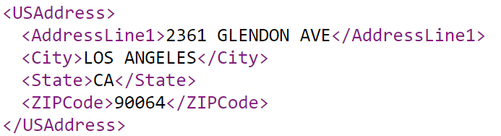
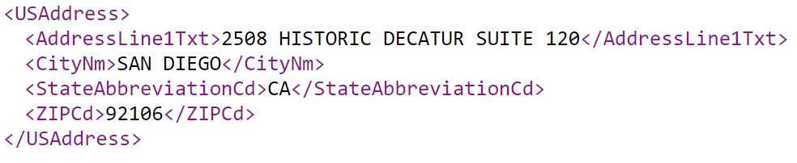
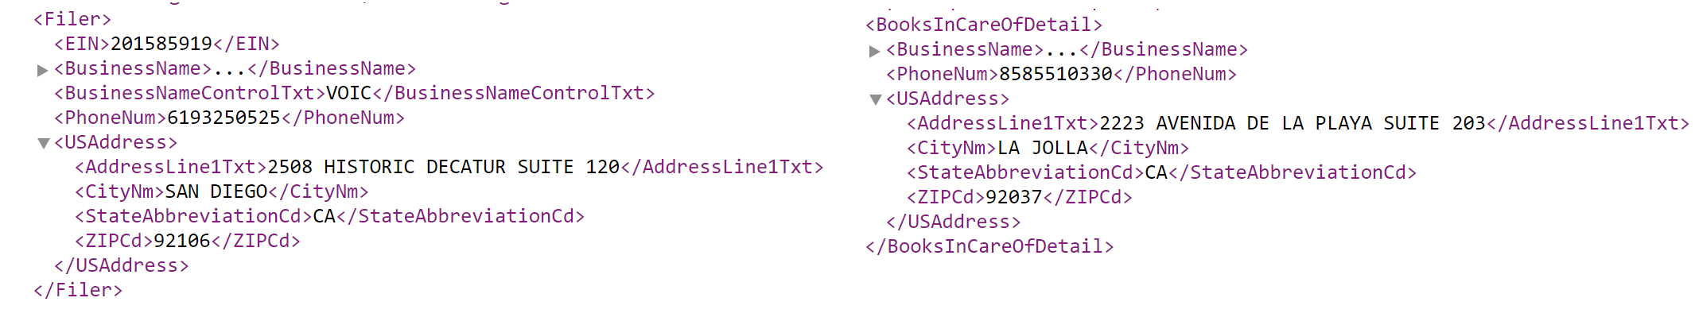
Element names are not consistent across all forms.
Multiple elements of same structure are contained inside other elements.
E.g - The Filer’s State and BooksInCareOfDetail State may not be the same.

Slide 6
My Approach
Iterate over the index_<year>.csv files and extract the OBJECT_ID.
Combine the object_id with ‘_public.xml’. This gives the Key to query the individual XML forms.
Create a file with each line consisting of a single <object_id>_public.xml
I used Apache Spark on Amazon’s Elastic MapReduce service to parse the XML files in a distributed manner.
Get a handle of the irs-form-990 bucket using boto (a python lib). Individual xml forms can then be extracted using the .get_key(URI) method
Use the .get_contents_as_string() method on the key to get the XML form in String format

Slide 7
Use xml.etree.cElementTree Toolkit to parse the XML for further processing
Create an elementTree reference using the URI extracted from the index file in the previous step
The namespace of the XML is : "//{http://www.irs.gov/efile}“
Use the .find() method on the tree to find interesting elements
E.g filer = tree.find(namespace+"Filer")
Find the EIN and STATE data inside Filer element
Since we know that STATE element tag can have slightly different names in different XML Forms I searched for the substring ‘state’ in the tag name.
Now, Total Revenue is contained inside ReturnHeader -> IRS990**.
Some forms have both previous year’s & current year’s total revenue while some only have total revenue. I handle this case similar to the STATE element discussed above.
Finally create a list consisting of EIN, STATE and TOTALREVENUE information.
This list will be passed to the Map Reduce tasks of the AWS EMR.

Slide 8
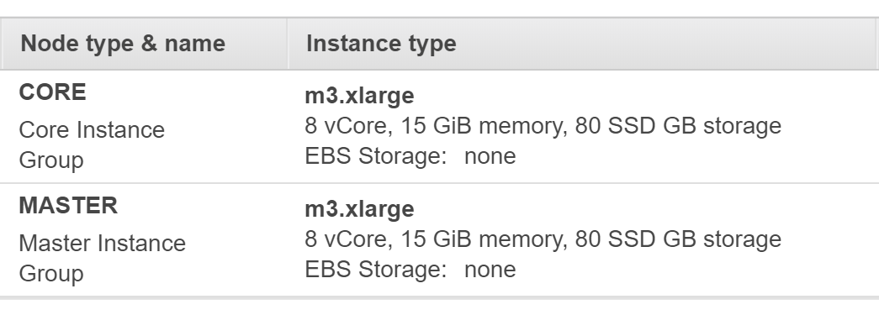
Parsing XML using EMR with SPARK
I used a cluster of 1 master node and 16 core nodes for processing.

Slide 9
Create an RDD from the processed index csv files.
Repartition the RDD into N blocks (Default 100).
The blocks then pass through mapping phase using UDF getCsvForPartition(). This function uses the boto library to obtain individual XML files and extracts the data using ElementTree toolkit.
Finally combine all results from the mapper phase and save it to private S3 bucket (My S3 bucket being ‘danny-irs990’)
Working code :
indexcsv.rdd.repartition(partitions).\
mapPartitions(lambda a:getCsvForPartition(a)).\
reduceByKey(lambda x,y : x)
The data is saved in csv format with the following structure :
Ein, state, total revenue, year
Using this data we can calculate the Year-over-year total revenue growth nationally and by state.

Slide 10
Performance and Results
Each index file had more than 200,000 references to XML Forms. The years 2016 & 2017 had more than 400,000 lines.
Processing of each index file on an average took 10-15min. However 2016 & 2017 took slightly longer to complete.
Performance could have been better using more powerful clusters and by adding extra nodes, however, AWS didn’t allow me to provision more than 16 nodes due to my limited Free Tier Account.

Slide 11
Year-Over-Year Revenue Growth Nationally
During the period 2011-2017 the National Revenue grew from $1.85 trillion to $2.28 trillion
YOY Growth Rate hit a record low on 2015 at -34.9%
2016 saw the highest YOY Growth Rate of 66.28% mainly because of very bad total national revenue on 2015.
Figure 1.1
Figure 1.2

Slide 12
YOY Revenue Growth Rate – AE to IN
Most States from AE to Indiana show slight increase in the YOY Total Revenue Growth Rate.
4 States AE, AP, Texas, and Hawaii had negative growth rate as on 2017.
Growth Rate was the least for most states during 2015.
Figure 2.1 – YOY Revenue Growth by State

Slide 13
YOY Revenue Growth Rate – KS to OH
Most States from Kansas to Ohio show slight increase in the YOY Total Revenue Growth Rate.
Only Michigan had an overall negative growth rate as on 2017.
Growth Rate was the least for most states during 2015.
Figure 2.2 – YOY Revenue Growth by State

Slide 14
YOY Revenue Growth Rate – OK to WY
Most States from AE to Indiana show slight increase in the YOY Total Revenue Growth Rate.
Puerto Rico had a slight decrease of 1.3% growth as on 2017.
Growth Rate was the least for most states during 2015 with Texas falling as low as 76%.
Figure 2.3 – YOY Revenue Growth by State

Slide 15
Interesting Observations
Although YOY total revenue growth rate has slightly increased nationally, 2015 was the worst year in terms of growth rate.
Majority of the states experience negative growth rates during 2015
2016 had the highest growth rate though it could also be due to the fact that 2015 was such a bad year for Total Revenue nationally.
All U.S Armed Forces regions had decreasing growth rate from 2011 to 2017 with an overall negative growth rate as of 2017
Texas has had a roller-coaster ride in terms of growth rate throughout 2011-2017

Slide 16
End Of Presenation
Daniyal Jahan
Graduate Student @TU Berlin

